Slide 1

Airline management system
Umair Ahmed(24377), Ali Iqbal(24529),

Slide 2
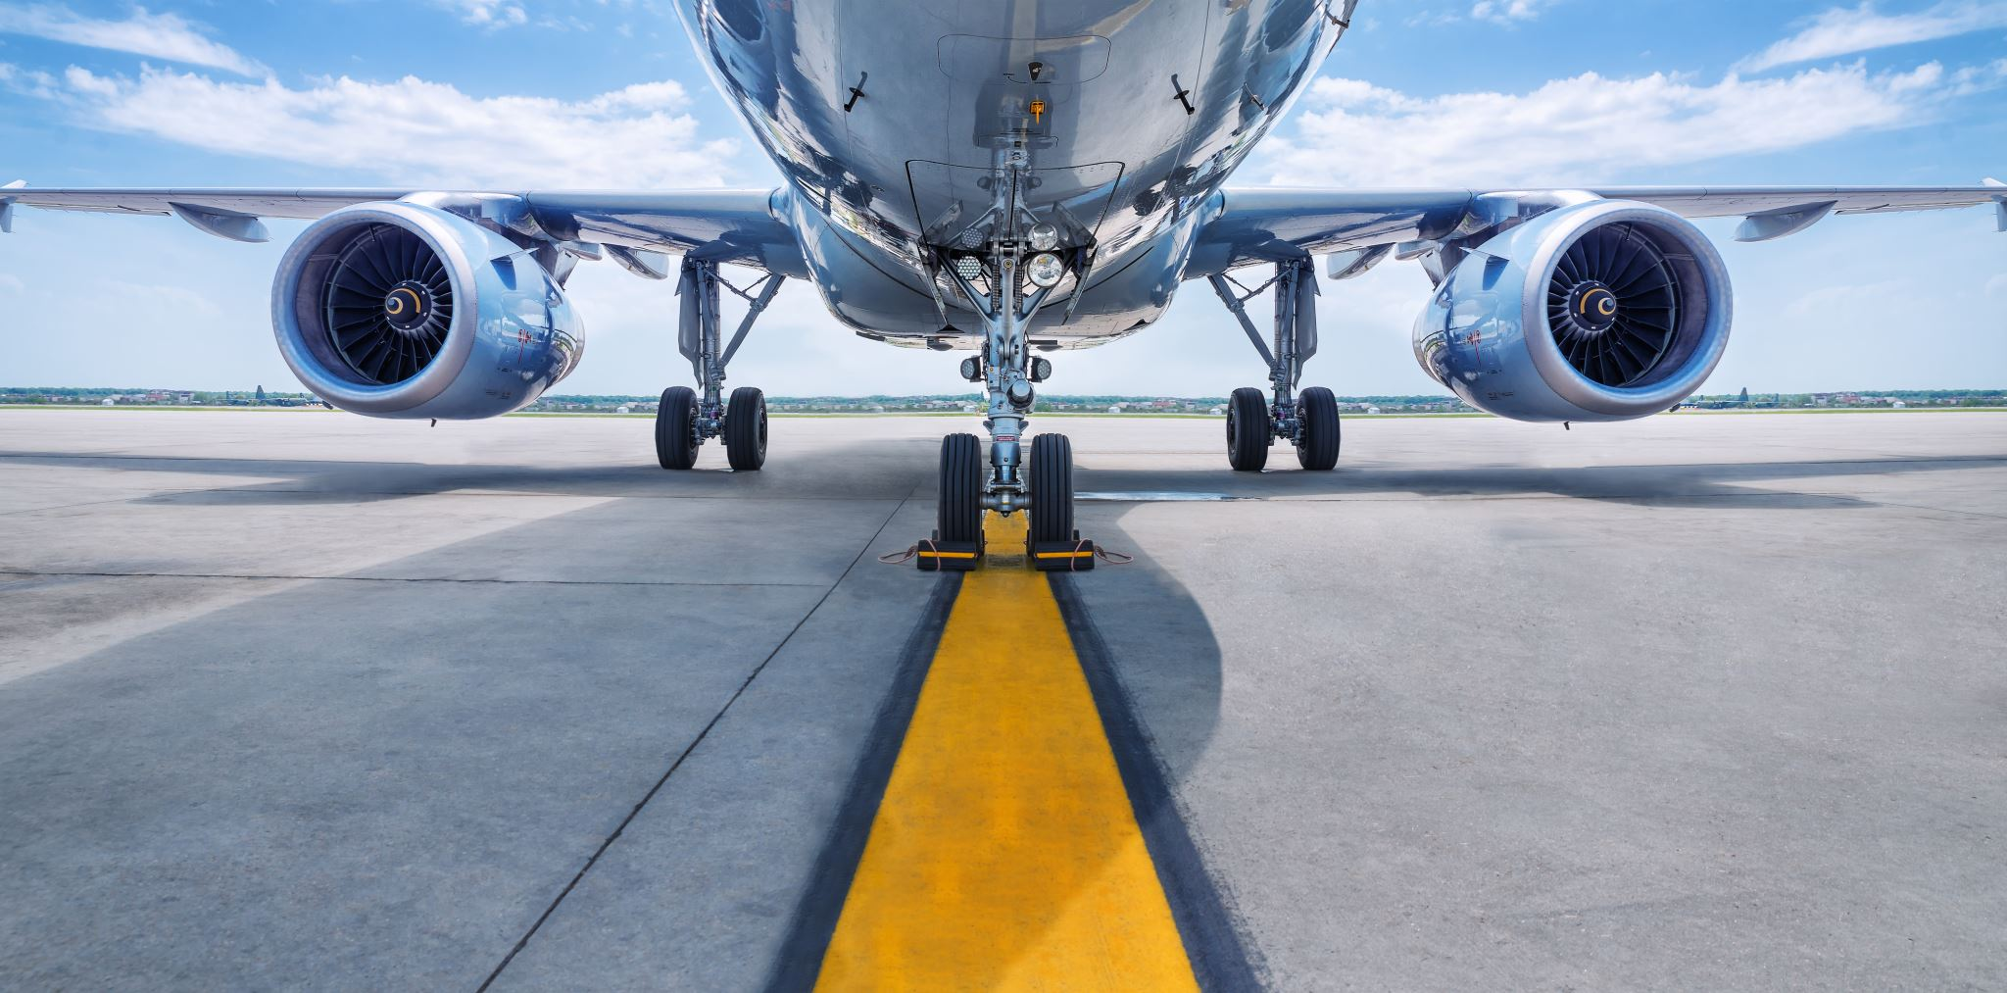
Business scenario
The system provides a comprehensive solution for managing all aspects of an airline’s operations
Customers can search for flights, book reservations, and make payments
The system tracks flight schedules, availability, and prices
Passengers can manage their reservations and cancel or update them
Internally, the system assigns pilots and crew members to flights and tracks their assignments
The system manages aircraft maintenance by assigning engineers to specific tasks and monitoring their progress

Slide 3

Business rules

Slide 4

User accounts have two types: customer and administrator(root admin with exclusive access to the entire application)
Email addresses should follow a valid format
Passwords must be at least 8 characters long
A user can book multiple flights on his/her behalf.
User

Slide 5

Reservations
Only one flight can be booked per reservation.
Payment is required to confirm a reservation else your reservation will be tentative and payment status will be “pending”.
Confirmed reservations decrease available seats on the flight.

Slide 6
Flights
Flight departure and arrival cities must be different.
Departure time must be before arrival time.
Available seats must be non-negative.
Flight price must be non-negative.

Slide 7
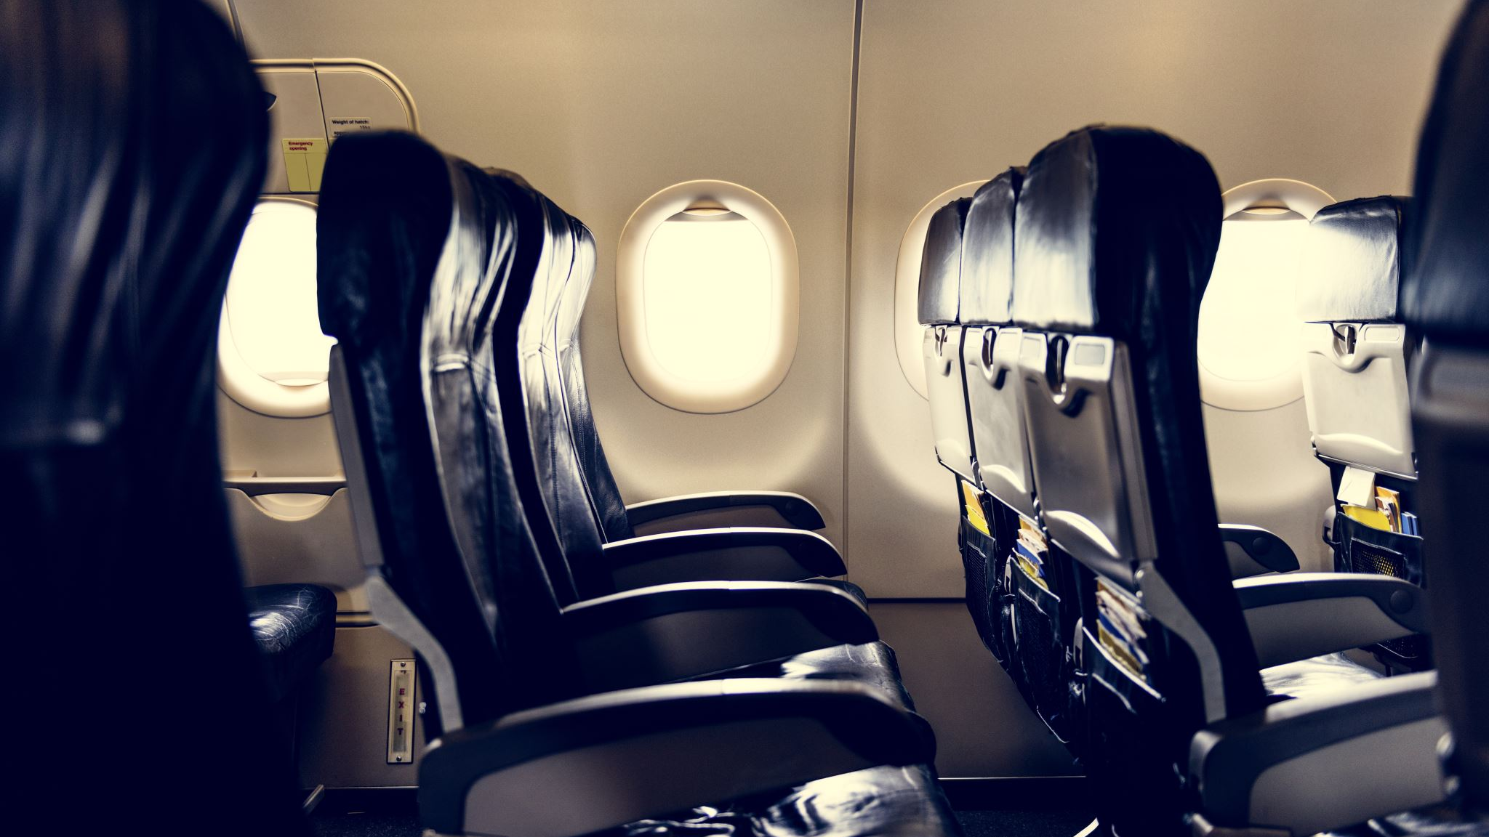
Passengers
Passenger accounts are created automatically upon booking a flight.

Slide 8

payments
Payment status can be "Successful" or "Failed".
Payment amount must be equal to the flight price.

Slide 9

Employees
There are four types of employees: Manager, Pilot, Cabin crew and Engineer.
An employee will be managed by single manager while a manager manages multiple employees.
Pilots, Cabin crews and Engineers should have separate interface for them to view their assignments.
Engineer will also have his/her assignment start and completion date

Slide 10

Database design

Slide 11
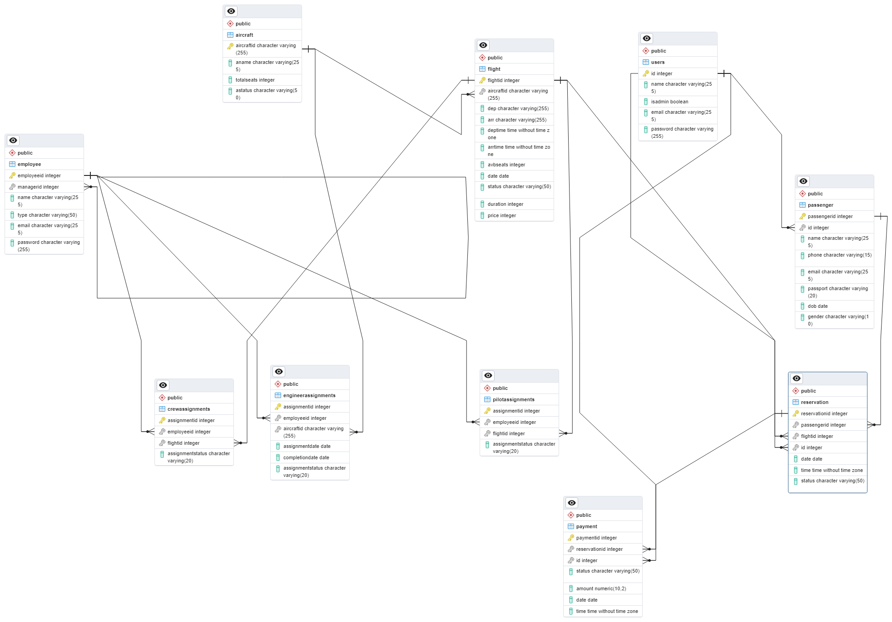
erd

Slide 12
User
Id
name
isAdmin
Email
Password

Slide 13
Flights
flightid (Primary Key)
aircraftid (Foreign key referencing Aircraft.aircraftid)
dep
arr
deptime
arrtime
avbseats
date
status
duration
price

Slide 14
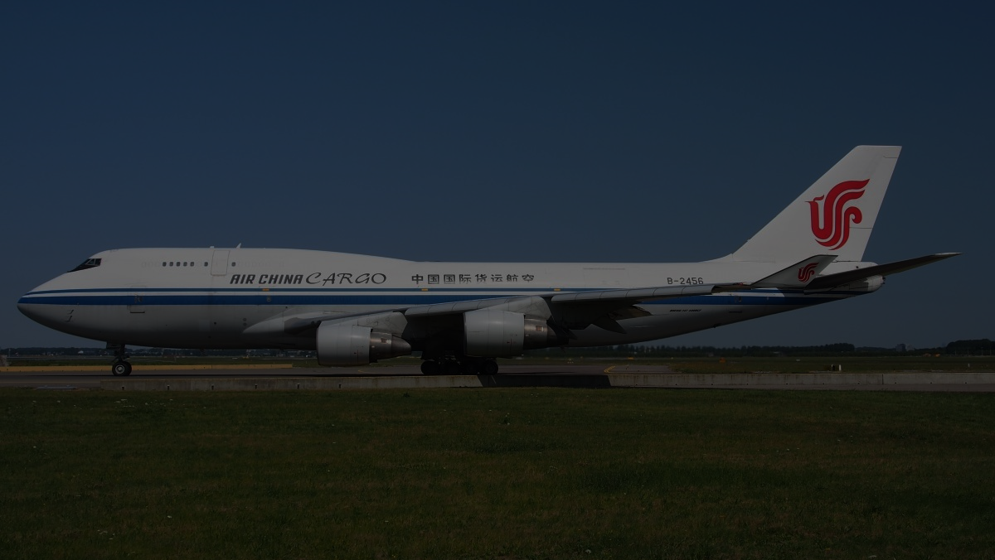
Aircraft
aircraftid (Primary Key)
aname
totalseats
astatus

Slide 15
Passengers
passengerid (Primary Key)
id (Foreign key referencing User.id)
name
phone
email
passport
dob
gender

Slide 16
payments
paymentid (Primary Key)
reservationid (Foreign key referencing Reservation.reservationid - optional)
id (Foreign key referencing User.id)
status
amount
date
time

Slide 17
Employees
employeeid (Primary Key)
managerid (Foreign key referencing User.id - optional)
name
type
email
password

Slide 18
Reservations
reservationid: (Primary Key)
passengerid: Foreign key referencing Passenger.passengerid.
flightid: Foreign key referencing Flight.flightid.
id: Foreign key referencing User.id.
Date
Time
status:

Slide 19
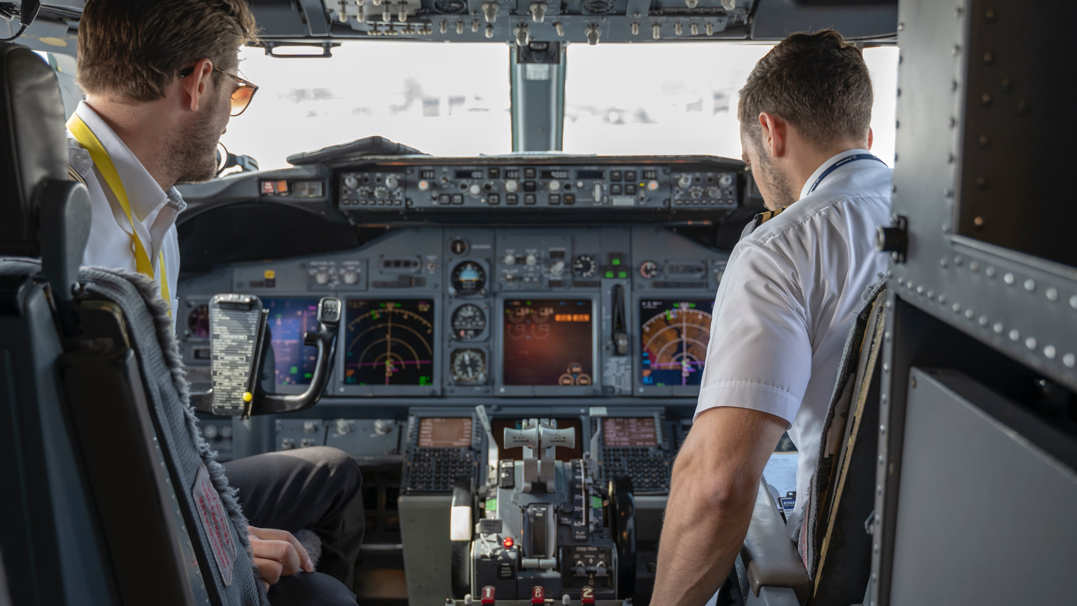
Pilot assignment
AssignmentID: (Primary Key)
employeeid: Foreign key referencing Employee.employeeid.
flightid: Foreign key referencing Flight.flightid

Slide 20
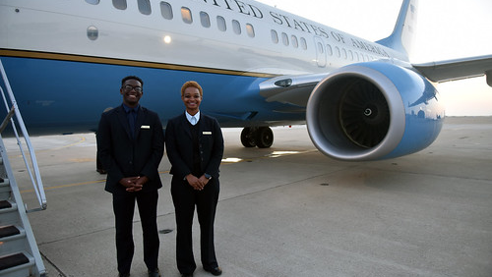
Crew assignment
AssignmentID: (Primary Key)
employeeid: Foreign key referencing Employee.employeeid.
flightid: Foreign key referencing Flight.flightid
This Photo by Unknown Author is licensed under CC BY

Slide 21
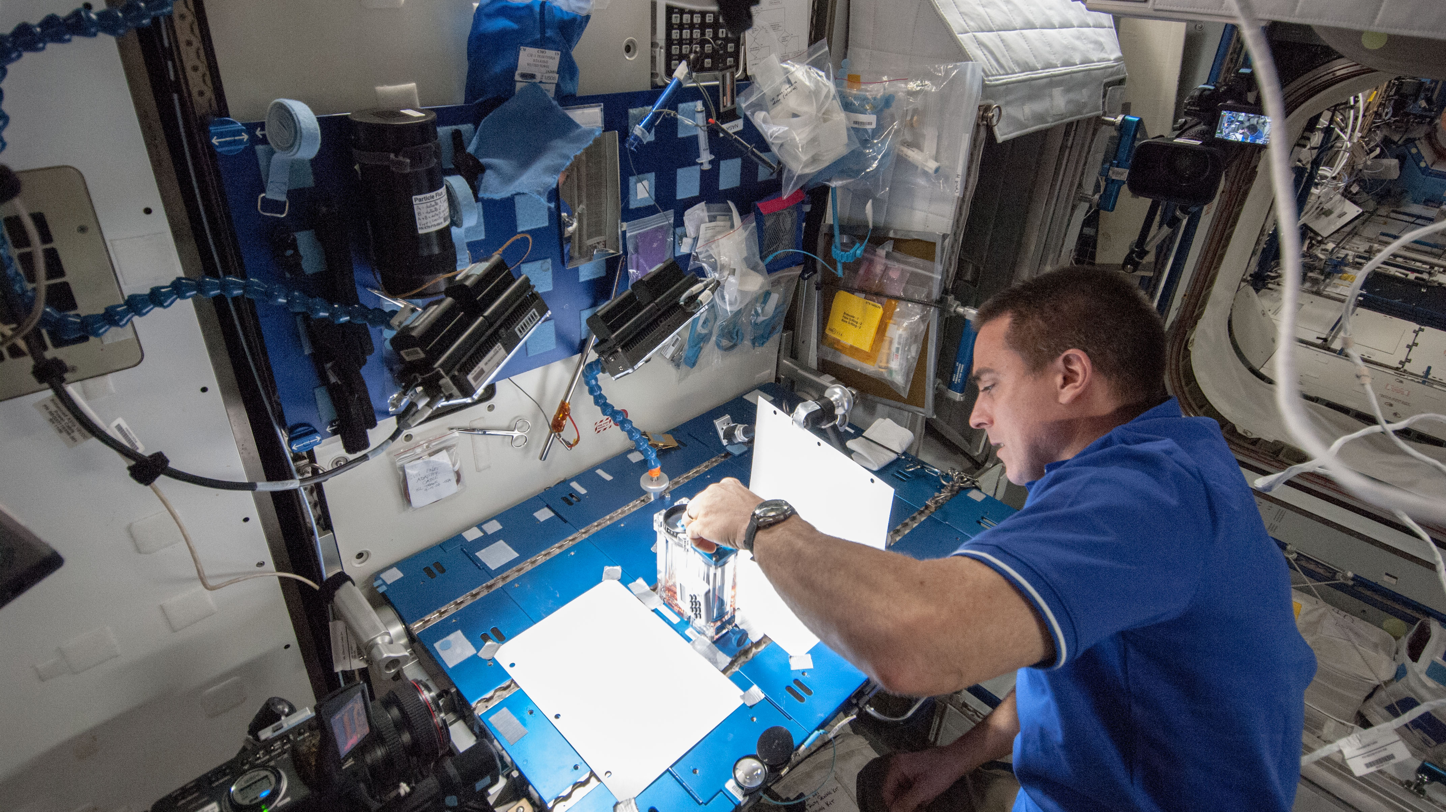
Engineer assignment
AssignmentID: (Primary Key)
employeeid: Foreign key referencing Employee.employeeid.
aircraftid: Foreign key referencing Aircraft.aircraftid
AssignmentDate
CompletionDate
AssignmentStatus
This Photo by Unknown Author is licensed under CC BY-SA

Slide 22

Functions & procedures

Slide 23

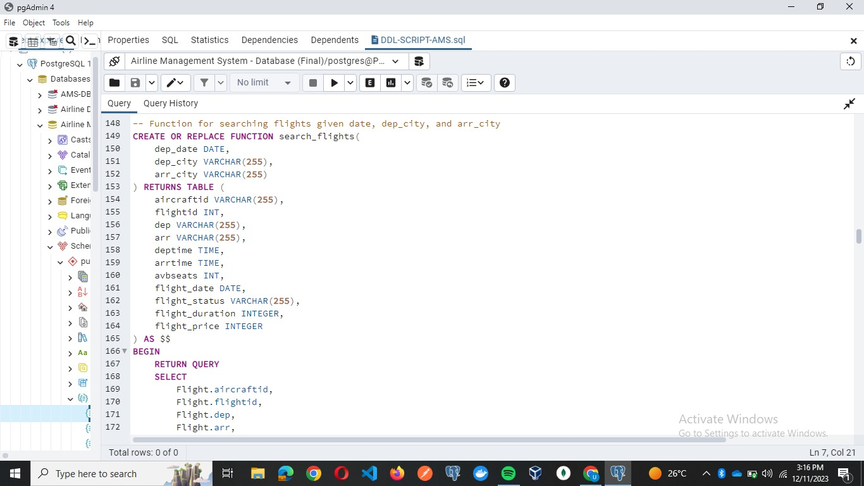
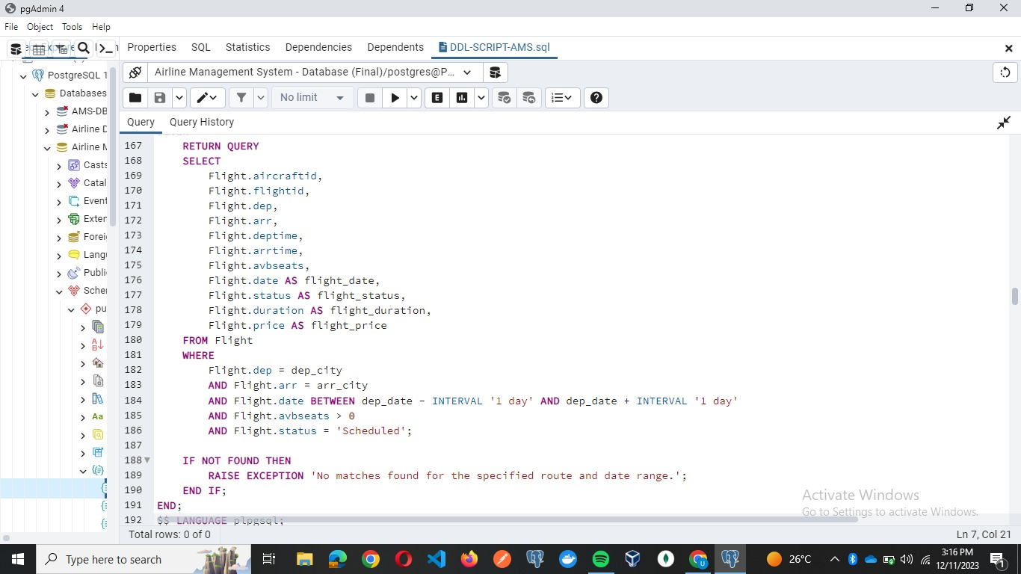
Search_flights

Slide 24
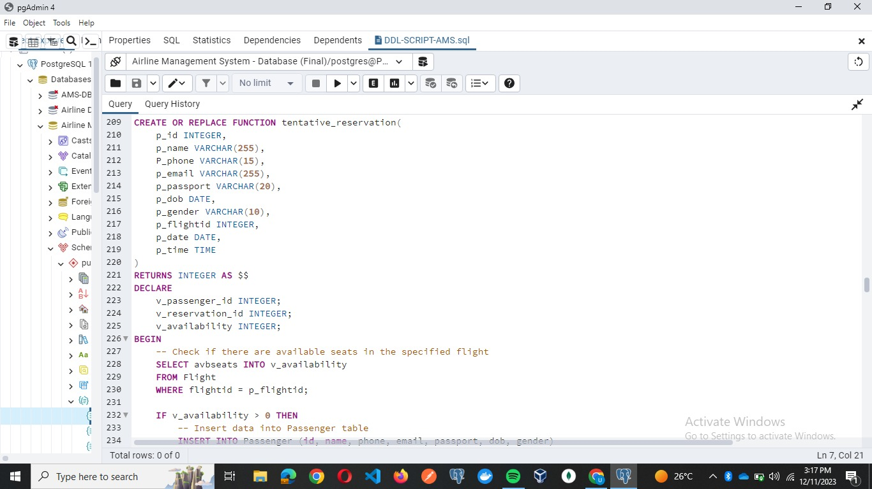
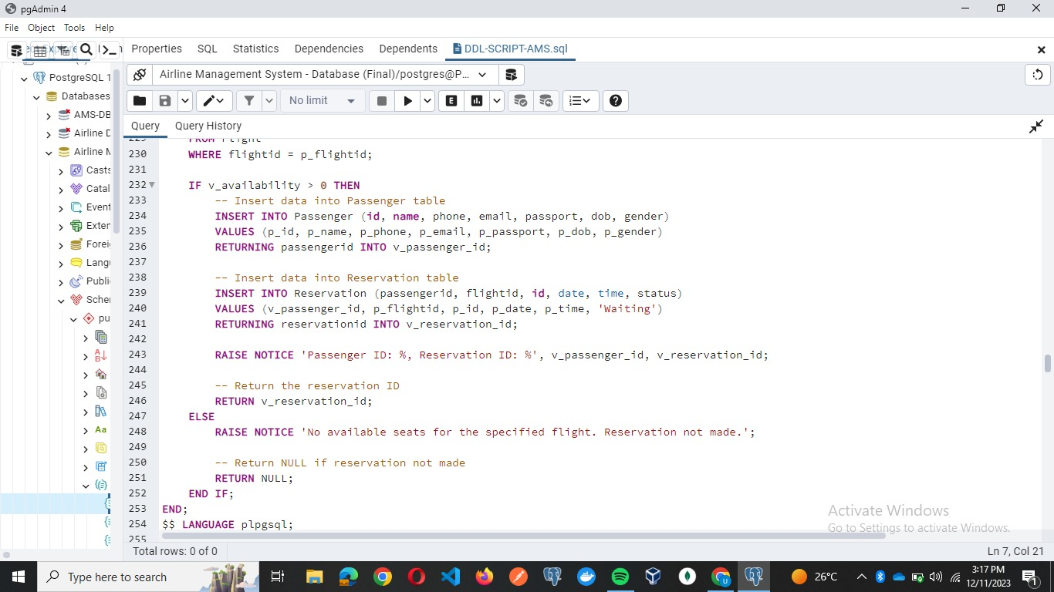
Tentative_reservation

Slide 25
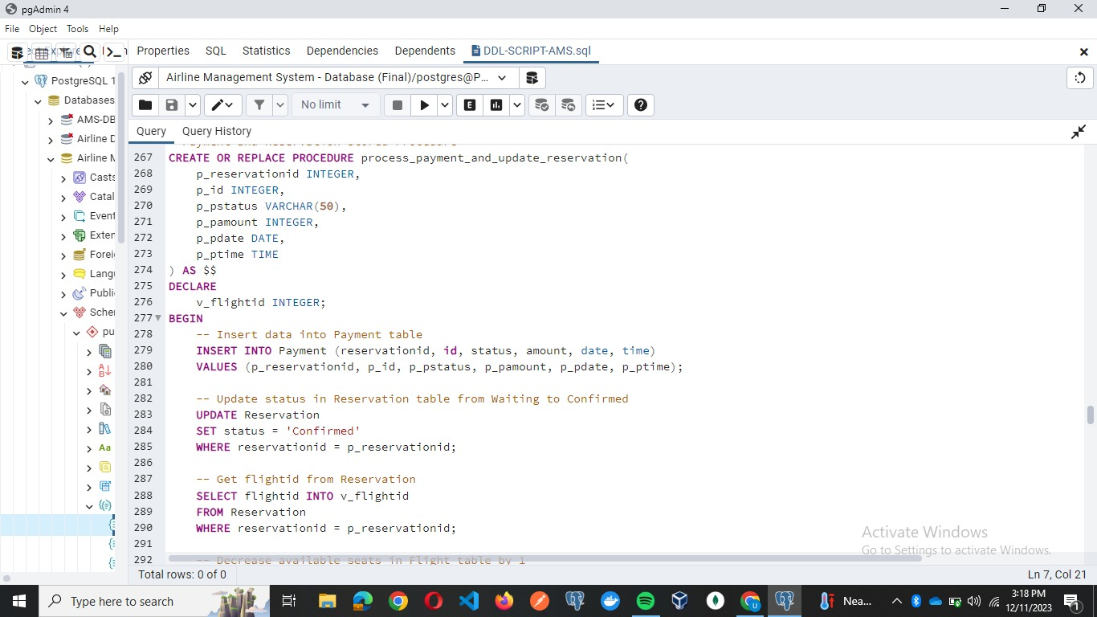
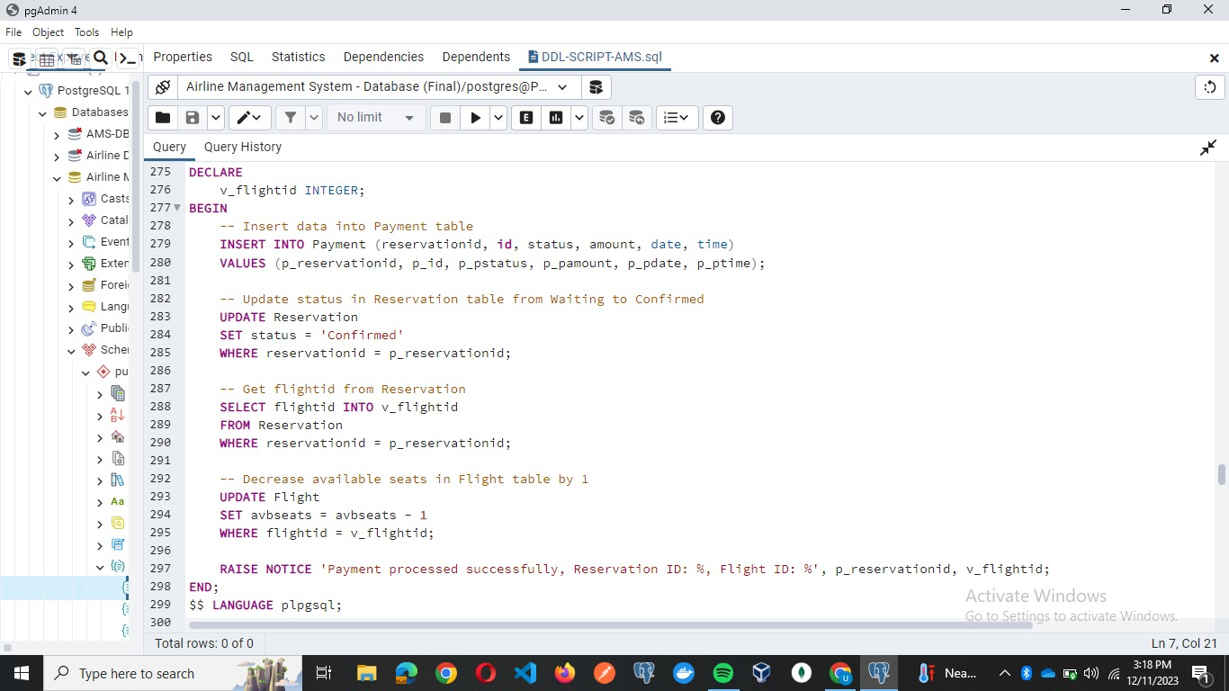
Process_payment_and_update_ reservation

Slide 26
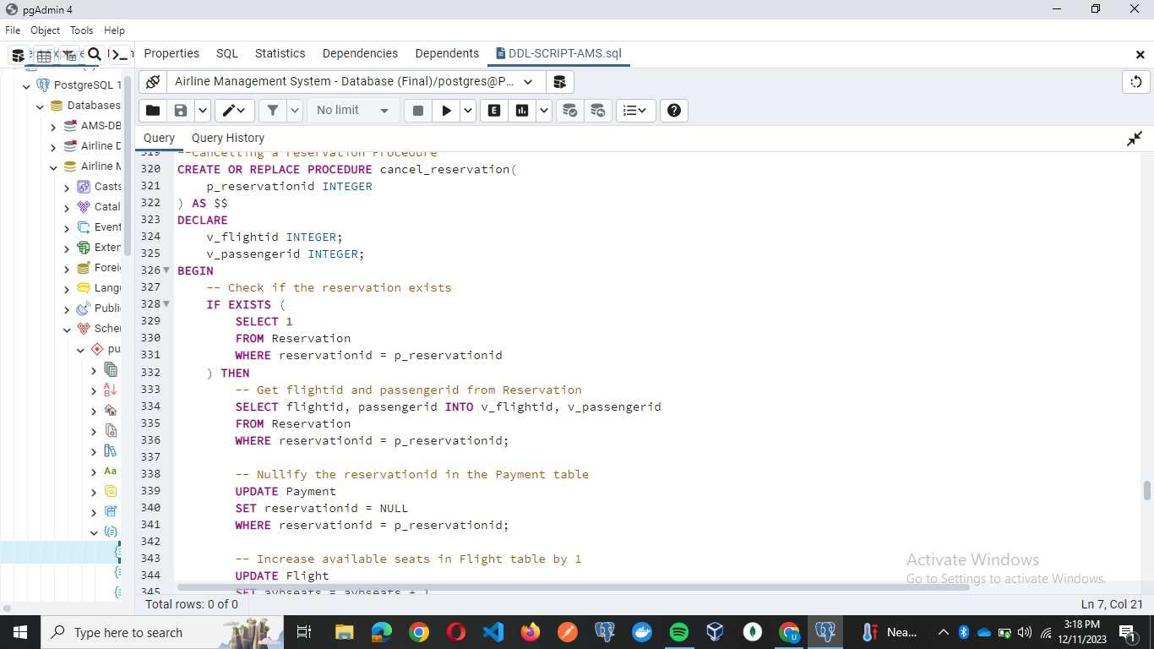
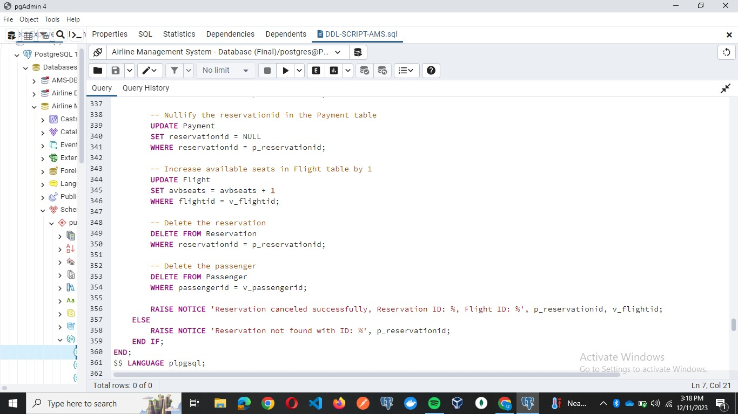
Cancel_reservation

Slide 27
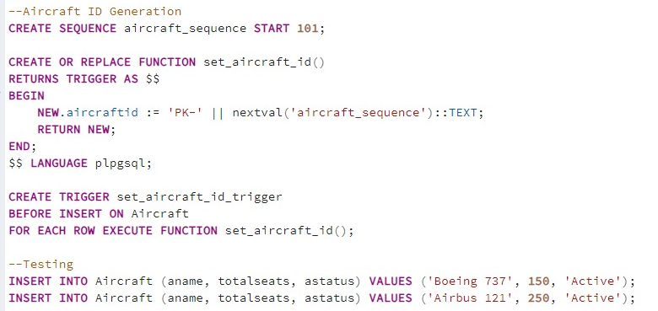
Set_aircraft_id (trigger)

Slide 28
Work Contribution
Ali Iqbal:
Designed the Initial Database Schema on Oracle DB.
Backend API Logic Building
Ali Khurram
Backend API creation and testing.
Report and PowerPoint Creation
Umair Ahmed
Converting the database to Postgres and fine-tuning it according to backend API needs
Frontend Development and Backend connection to the frontend.

Slide 29

Thank you

